Slide 1
It’s Not All In Your Head
Mood and the Microbiome
Jeremy Appleton, ND

Slide 2

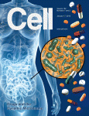
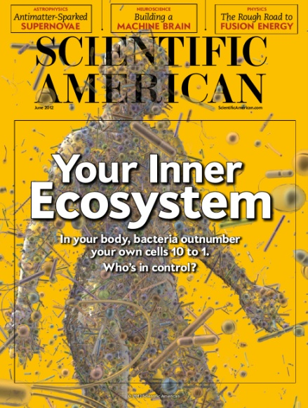
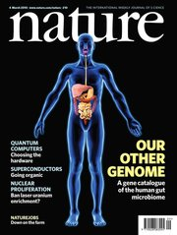


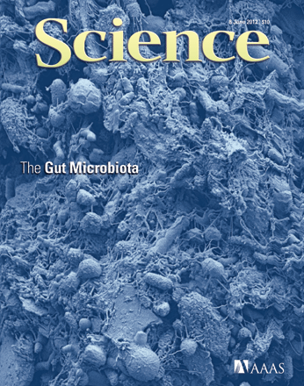
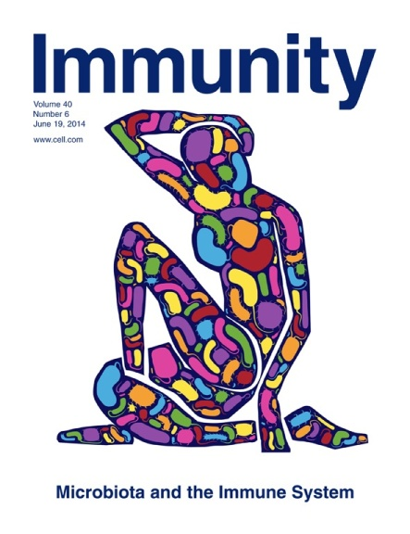
Notes:
For the last couple of years, we have seen this frontier of research edging into the mainstream of scientific awareness, and not without skepticism to temper some of the irrational exuberance.
So here I’d like to take a look into some of the main mechanisms by which the gut and brain interact, how the gut microbiome might play a decisive role, and the beginnings of clinical evidence of efficacy for probiotics as a therapeutic modality for mental health.

Slide 3
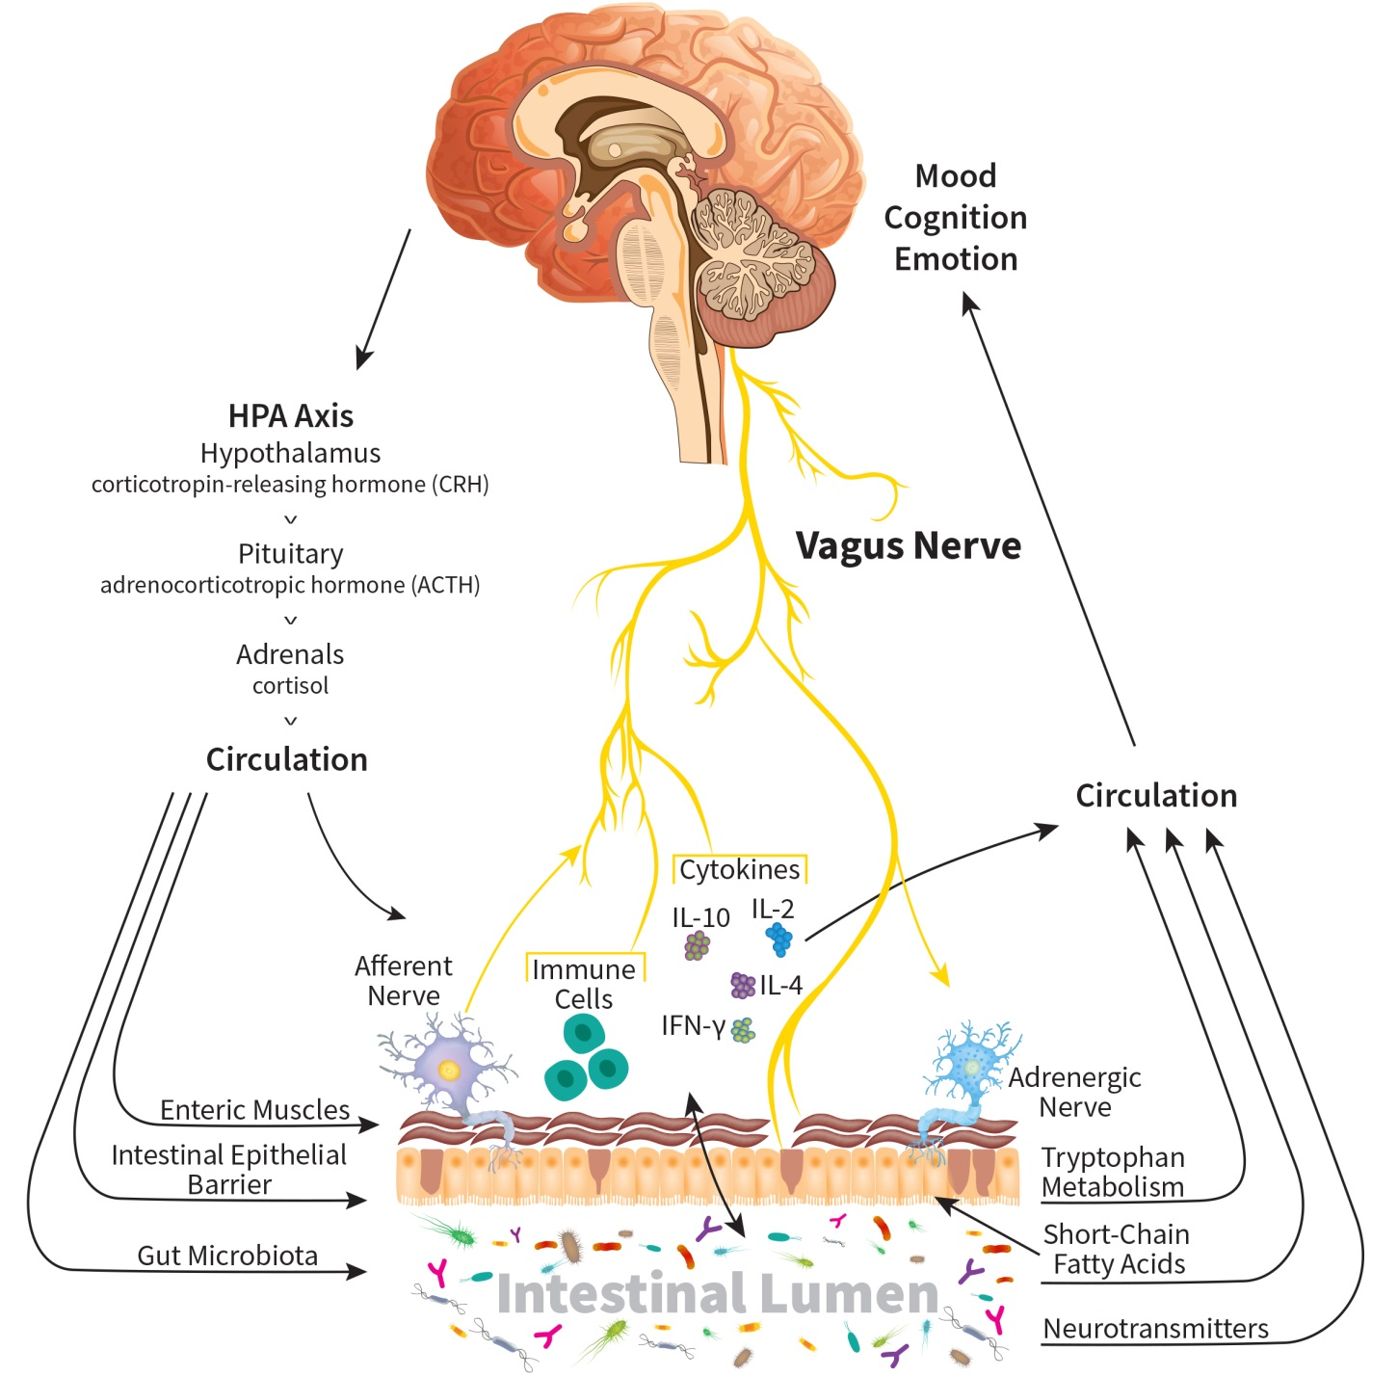
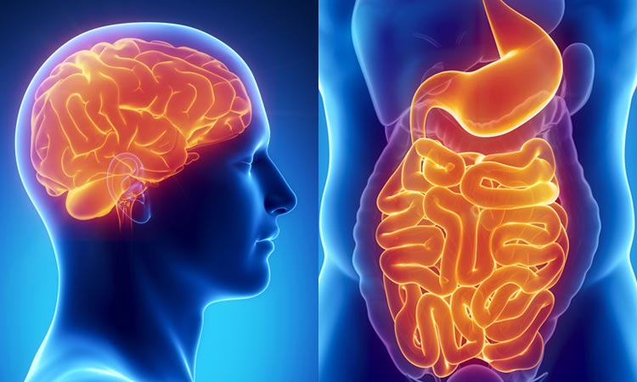
What is the Gut-Brain Axis?
Neurologic
Endocrine
Humoral Metabolic
Immune
Notes:
The GBA is biochemical and neurologic signaling system by which the CNS communicates with the enteric nervous system.
There is bi-directional communication between the gut and brain. How precisely it operates is still a matter of intense investigation on many fronts
So far most findings linking the microbiota with host neuro-physiological processes have originated from rodent studies.
Many studies have made use of animals raised in a sterile, germ-free environment. Using this approach it was found that the microbiota is critical for the host’s serotonergic system and tuning the stress response at a behavioral and endocrine level, which has further implications for our perception of stress-related psychiatric and gastrointestinal diseases.
While these findings are stimulating, it has to be acknowledged that germ-free animals represent a highly artificial model and while it may be useful to determine certain physiological it’s not a particularly translatable model for human disease. But these studies, in addition to in vitro research, do give valuable insights into the main pathways of interaction between the gut and brain:
Neurologic (i.e., the vagus nerve, the enteric nervous system, and the activity of neurotransmitters such as serotonin and GABA)
Endocrine (i.e., the influence and feedback mechanisms of hormones, such as cortisol, ACTH and CRF)
Humoral/Metabolic (i.e., bacterial metabolites such as (+) short-chain fatty acids and their effects on enterocytes; production of antibodies against LPS from gram-negative enterobacteria are higher in patients with major depression than in controls, and cause stress-associated with increased gut permeability and bacterial translocation in animal models.)
Immune (i.e., inflammatory modulation via cytokines and other mediators)
“Thus, both neural and hormonal lines of communication combine to allow brain to influence the activities of intestinal functional effector cells, such as immune cells, epithelial cells, enteric neurons, smooth muscle cells, interstitial cells of Cajal and enterochromaffin cells. These same cells, on the other hand, are under the influence of the gut microbiota [3] whose contributing role in brain-gut reciprocal communications has recently been assessed.” - Carabotti
Chart from: Borrelli L et al. Probiotic modulation of the microbiota-gut-brain axis and behaviour in zebrafish. Scientific Reports 2016; 6:30046 | DOI: 10.1038/srep30046
https://www.nature.com/articles/srep30046.pdf

Slide 4
How the microbiota interacts with the GBA
Neurologic
modulation of afferent sensory nerves
directly producing molecules that can act as local neurotransmitters
Endocrine
alter nutrient availability
influence the release of biologically active peptides from enteroendocrine cells
Humoral / Metabolic
SFCAs stimulate mucosal serotonin release, cross the BBB, modulate brain dev and behavior
Immune
abnormal microbiota activates mucosal innate immune responses, which increase epithelial permeability
also affects intestinal motility and secretion, visceral sensitivity , cellular alterations
generating a biologically active form of catecholamines
galanin and ghrelin effects on HPA Axis, cortisol, etc
SFCAs: fuel for enterocytes, affect intestinal permeability, stimulate ANS via GPR receptors
SCFAs regulate gut peptides, synthesis of serotonin
SCFAs are immunomodulatory
Notes:
And the germ-free rodent studies also provided another critical insight: that bacterial colonization of the gut is central to development and maturation of both the enteric and central nervous systems.
Both clinical and experimental evidence now suggest that enteric microbiota has an important impact on GBA: on memory, mood, stress, cognition, neuromuscular function, regulation of the HPA Axis, and more. Here are some examples of how they can do it. This is far from an inclusive list…
Neurologic modulation of afferent sensory nerves; directly producing molecules that can act as local neurotransmitters, such as GABA, serotonin, melatonin, histamine and acetylcholine; generating a biologically active form of catecholamines in the lumen of the gut .
Endocrine: Gut microbiota alter nutrient availability and thus might influence the release of biologically active peptides from enteroendocrine cells that can affect the GBA. “For example, galanin stimulates the activity of the central branch of the HPA axis (i.e. the release of CRF and ACTH), thereby enhancing glucocorticoid secretion from the adrenal cortex. Galanin also is able to stimulate directly cortisol secretion from adrenocortical cells, and norepinephrine release from adrenal medulla. Ghrelin too possesses a marked ACTH/cortisol-releasing effect in humans and it is probably involved in the modulation of the HPA response to stress and nutritional/metabolic variations.”
Humoral / Metabolic: SCFAs, produced by the bacterial fermentation of dietary carbohydrates:
have immunomodulatory properties
can interact with nerve cells by stimulating the sympathetic and autonomic nervous system via G-protein-coupled (GPR) receptor 41 (GPR41) and GPR43.
In addition, they can cross the BBB, modulate brain development and behaviour
and have been implicated in the development of autism.
Further, gut microbiota derived SCFAs have been shown to regulate microglia homoeostasis, necessary for proper brain development and brain tissue homoeostasis.
SCFAs also regulate the release of gut peptides from enteroendocrine cells, which in turn affect gut–brain hormonal communication.
They have recently been shown to regulate the synthesis of gut-derived serotonin from enterochromaffin cells. The gut provides ~ 95% of total body serotonin, most of which exists in plasma. Although this source of serotonin has intrinsic roles within the gut and peripherally in metabolic control, it can also locally activate afferent nerve endings to signal to the CNS.
This source of serotonin has significant links to psychiatric disorders with the most commonly used antidepressant, fluoxetine, blocking the transport of gut serotonin into plasma, while elevated plasma serotonin is observed in 25–50% of children with autism, and an inverse correlation between high plasma serotonin and low serotonergic neurotransmission has been demonstrated in young male adults with autism spectrum disorder.
In addition to SCFAs, gut bacteria are also capable of producing an array of other neuroactive and immunomodulatory compounds, including dopamine, GABA, histamine, and acetylcholine, while the gut microbiome is an important regulator of bile acid pool size and composition,221 and, in turn, BBB integrity and HPA function.
Immune: In IBS as an example, abnormal microbiota activates mucosal innate immune responses, which increase epithelial permeability, activate gut pain sensory pathways, and dysregulates the enteric nervous system. Both brain-gut and gut-brain dysfunctions occur, the former being dominant particularly in irritable bowel syndrome (IBS) [13]. The disruption occurring in the GBA determines changes in intestinal motility and secretion, causes visceral hypersensitivity and leads to cellular alterations of the entero-endocrine and immune system.

Slide 5
How the microbiota interacts with the GBA
Production, expression and turnover of neurotransmitters (i.e., serotonin, GABA) and neurotrophic factor (BDNF)
Protection of intestinal barrier and tight junction integrity
Modulation of enteric sensory afferents
Bacterial metabolites
Mucosal immune regulation
Gut to Brain
Brain to Gut
Alteration in mucus and biofilm production
Alteration in motility
Alteration of intestinal permeability
Alteration in immune function
Ann Gastroenterol. 2015;28:203-9.
Notes:
REF: Carabotti

Slide 6
Epithelial Barrier Function
Intestinal barrier integrity is a prerequisite for mucosal function homeostasis.
Disruption of epithelial barrier integrity is associated with many diseases:
  infection by pathogens
  obesity and diabetes
  necrotizing enterocolitis
  irritable bowel syndrome
  inflammatory bowel disease
Modulation of intestinal barrier function is likely a primary factor in microbiota-GBA interaction.
Br J Nutr. 2017;117(1): 93-107.
Notes:
When we search for clues in the gut that might present a unifying theory for the pathogenesis of many varied conditions, we keep seeing evidence that points to disruption of epithelial barrier integrity as one of the major etiological factors. It is associated with several gastrointestinal diseases, including infection by pathogens, obesity and diabetes, necrotizing enterocolitis, irritable bowel syndrome and inflammatory bowel disease.
We now know that intestinal barrier function is also linked to brain and neurologic function. Microbiota may interact with GBA through different mechanisms we saw on the last slide, the principal one likely being modulation of the intestinal barrier. Perturb that barrier and you can influence all the underlying compartments. In fact, the major cause of death in surgical ICUs is the failure of gut barrier function, leading to sepsis.
Probiotic species-specific central effects are associated with the restoration of tight-junction integrity and the protection of intestinal barrier
REF: Bron PA, Kleerebezem M, Brummer R-J, Cani PD. Can probiotics modulate human disease by impacting intestinal barrier function? Br J Nutr. Volume 117, Issue 1 January 2017, pp. 93-107.

Slide 7
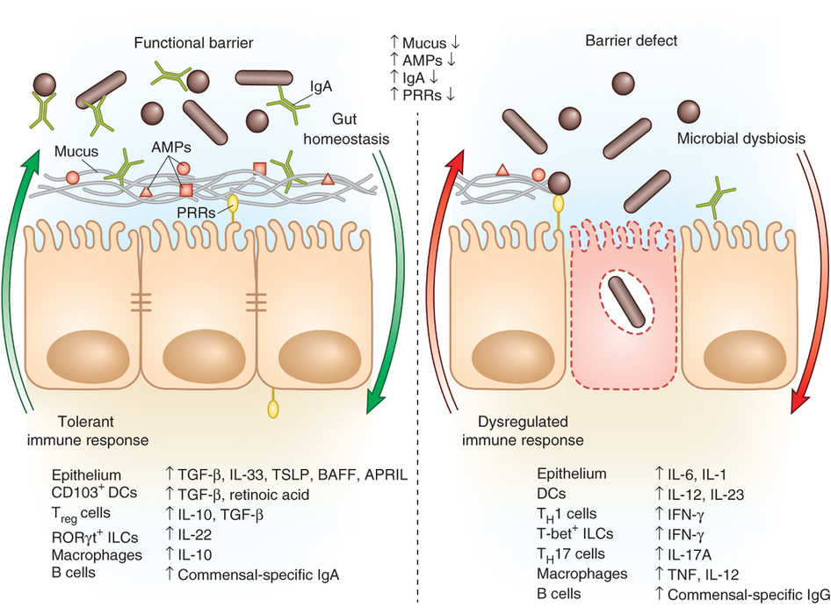
Epithelial Barrier Function
Nature Immunology. 2013;14: 660-7.
Notes:
This slide illustrates the COMPLEXITY of the interactions going on at the brush border that MAINTAIN epithelial cell TIGHT JUNCTIONS and normal barrier function.
We see
pattern recognition receptors (PRRs),
Mucus (The microbiota is actually SECREGATED away from the intestinal epithelial cells (IECs) by this layer of mucus, through which the intestinal immune system directs a largely tolerant response to the resident commensals)
antimicrobial proteins (AMPs)
secreted IgA
All of which promote intestinal HONMEOSTASIS with the microbiota, all of which are INCREASED when the epithelial barrier is FUNCTIONAL; and which are DECREASED when a barrier DEFECT is present
There’s a lot of other stuff going on here, too, as you can see: alternations of various cytokines and immune cells that accompany a functional versus dysfunctional barrier. In other words, the elements causing and contributing to the phenomenon of a LEAKY GUT. I won’t get into it here, but I WOULD recommend the excellent article from Nature Immunology in 2013 called: The role of the immune system in governing host-microbe interactions in the intestine by Eric Brown and colleagues at the University of British Columbia.
TMI:
Microbial-associated molecular patterns (MAMPs) stimulate the epithelial secretion of factors (IL-33, TGF-β, TSLP, BAFF and APRIL) that promote development of tolerogenic immune cell responses to the microbiota.
This cytokine environment enriches for CD103⁺ dendritic cells (DCs), which aid in the development of T_{reg} cells secreting IL-10 and TGF-β. T_{reg}cells and CD103⁺ DCs stimulate the production of commensal-specific IgA.
Barrier integrity of the IECs is enhanced by secretion of IL-22 by RORγt ILCs in this environment.
In immunodeficiency or inflammatory syndromes with an innate barrier defect (for example, IBD, CVID or HIV infection), the intestinal immune system directs a potentially harmful pro-inflammatory response to the microbiota to clear invading bacteria and dysbiosis occurs. In this environment, the epithelium can secrete IL-1 and IL-6 in response to danger signals. Secretion of IL-12 and IL-23 by DCs and macrophages promote a T_{H}1 and T_{H}17 response. These T helper cells secrete high levels of IFN-γ and IL-17A, respectively, and T-bet⁺ ILCs also accumulate to produce IFN-γ. A breach in the epithelial barrier by the microbiota in this situation can also lead to higher levels of B cells secreting commensal-specific IgG.
REF: Brown EM, et al. The role of the immune system in governing host-microbe interactions in the intestine. Nature Immunology 14, 660–667 (2013) doi:10.1038/ni.2611

Slide 8
Microbiome and Inflammation
Gut microbiota help maintain tight junctions.
Dysbiosis and associated increases in intestinal permeability are now recognized features of many diseases.
Stressful stimuli alter permeability of the intestinal epithelium. Permeability defects are thought to underlie chronic, low-grade inflammation.
Inflammatory phenotype contributes to depression by altering neurotransmitter metabolism, reducing the availability of neurotransmitter precursors, and activating the HPA axis.
Bacterial-derived endotoxins (e.g., LPS) trigger immune activation.
Reducing inflammation of this origin may lead to improved regulation of the HPA axis and neurotransmitter activity.
Notes:
Gut microbiota are well known to help maintain tight junctions between gut epithelial cells. It should therefore come as no surprise that dysbiosis and associated increases in intestinal permeability are now recognized features of rheumatoid arthritis, Alzheimer's disease, asthma, even autism spectrum disorders, and other systemic ills both inflammatory and otherwise.
While it was once a theoretical notion, it has now been amply demonstrated that stressful stimuli alter permeability of the intestinal epithelium, allowing bacterial antigens and lipopolysaccharides to leak into the circulation and become humoral influencers, stimulating immune responses in the intestinal mucosa and beyond.²⁰⁻²⁴ These stress-induced alterations in epithelial cell junction permeability can be seen as actual morphological changes to colonic epithelial cells, altered colonocyte differentiation, decreased expression of mRNA encoding tight junction proteins (ie, reduced genetic expression of tight junction protein 2), overproduction of interferon-γ, and activation of glial and mast cells in the gut.²⁵ Resultant intestinal permeability defects are thought to underlie the chronic, low-grade inflammation observed in disorders such as depression.²⁶
Depression is increasingly recognized as having an inflammatory component. Anti-inflammatory drugs, such as cyclooxygenase (COX)-2 inhibitors, have previously demonstrated efficacy in major depression.⁴² Even the mainstream media has picked up on the connection between depression and inflammation.⁴³⁻⁴⁵ An inflammatory phenotype contributes to depression in a number of ways, notably by altering neurotransmitter metabolism, reducing the availability of neurotransmitter precursors, and by activating the HPA axis.⁴⁶ This inflammation is thought to be caused by intestinal permeability defects. In particular, gut-derived endotoxins called lipopolysaccharides (LPS), which originate from the outer membranes of gram-negative bacteria, trigger immune activation through Toll-like receptor 4 (TLR4).⁴⁷ Reducing inflammation of this origin may thus lead to improved regulation of the HPA axis and neurotransmitter activity.
REFS:
20. Kiliaan AJ, Saunders PR, Bijlsma PB, et al. Stress stimulates transepithelial macromolecular uptake in rat jejunum. Am J Physiol. 1998;275(5 Pt 1):G1037-G1044.
21. Groot J, Bijlsma P, Van Kalkeren A, et al. Stress-induced decrease of the intestinal barrier function. The role of muscarinic receptor activation. Ann NY Acad Sci. 2000;915:237-246.
22. Yates DA, Santos J, Söderholm JD, Perdue MH. Adaptation of stress-induced mucosal pathophysiology in rat colon involves opioid pathways. Am J Physiol Gastrointest Liver Physiol. 2001;281(1):G124-G128.
23. Söderholm JD, Yates DA, Gareau MG, et al. Neonatal maternal separation predisposes adult rats to colonic barrier dysfunction in response to mild stress. Am J Physiol Gastrointest Liver Physiol. 2002;283(6):G1257-G1263.
24. Jacob C, Yang PC, Darmoul D, et al. Mast cell tryptase controls paracellular permeability of the intestine. Role of protease-activated receptor 2 and beta-arrestins. J Biol Chem. 2005;280(36):31936-31948.
25. Demaude J, Salvador-Cartier C, Fioramonti J, et al. Phenotypic changes in colonocytes following acute stress or activation of mast cells in mice: implications for delayed epithelial barrier dysfunction. Gut. 2006;55(6):655-661.
26. Kelly JR, Kennedy PJ, Cryan JF, et al. Breaking down the barriers: The gut microbiome,intestinal permeability and stress-related psychiatric disorders. Front Cell Neurosci. 2015;9:392.
42. Müller N, Schwartz MJ, Dehning S, et al. The cyclooxygenase-2 inhibitor celecoxib has therapeutic effects in major depression: results of a double-blind, randomized, placebo controlled, add-on pilot study to reboxetine. Mol Psychiatry. 2006;11(7):680-684.
43. Williams C. Is depression a kind of allergic reaction? January 4, 2015. The Guardian. Available at: https://www.theguardian.com/lifeandstyle/2015/jan/04/depression-allergic-reaction-inflammation-immune-system. Accessed January 4, 2018.
44. Morgan E. Could Depression Actually Be Nothing More Than an Allergic Reaction? January 5, 2015. Vice. Available at: https://www.vice.com/sv/article/av4pdj/is-depression-an-allergic-reaction-039. Accessed January 4, 2018.
45. DeChant T. Depression May Be Caused by Inflammation. January 5, 2015. Nova Next. PBS Web site. http://www.pbs.org/wgbh/nova/next/body/depression-may-caused-inflammation/. Accessed January 3, 2018.
46. Wallace CJK, Milev R. The effects of probiotics on depressive symptoms in humans: a systematic review. Ann Gen Psychiatry. 2017;16:14.
47. Kawai T, Takeuchi O, Fujita T, et al. Lipopolysaccharide stimulates the MyD88-independent pathway and results in activation of IFN-regulatory factor 3 and the expression of a subset of lipopolysaccharide-inducible genes. J Immunol. 2001;167(10):5887-5894.

Slide 9
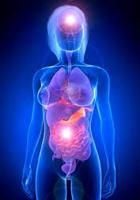
Probiotics and Mood
Systematic review by Wallace and Miley
10-study inclusion criteria
  5 studies assessed mood symptoms
  7 studies assessed anxiety symptoms
  3 studies assessed cognition
The majority of the studies found positive results on all measures of depressive symptoms
Strains, dosing, and duration of treatment varied widely.
No studies assessed sleep.
Ann Gen Psychiatry. 2017;16:14.
Notes:
So all of this invites the obvious question: can modulating the intestinal microbiome via supplementation with probiotics alter mood and other neurologic conditions?
Very few clinical trials have begun investigating the effect of probiotics for mood disorders such as depression and anxiety. But there have been SOME. As clinical trials validating these concepts have begun to emerge in the last decade, a new class of probiotics also emerged – the so-called psychobiotics, or psychomicrobiotics – which hold significant promise for new, nontoxic treatment of psychiatric disorders.^{71,72} Several human clinical trials have now investigated the effects of probiotics for mood disorders such as depression and anxiety
Just last year there was a systematic review of the research, by Wallace and Milev.
The accepted ten studies that met their inclusion criteria
Five studies assessed mood symptoms,
seven studies assessed anxiety symptoms,
and three studies assessed cognition.
The majority of the studies found positive results on all measures of depressive symptoms; however, the strain of probiotic, the dosing, and duration of treatment varied widely and no studies assessed sleep.
Conclusion: The evidence for probiotics alleviating depressive symptoms is compelling but additional double-blind randomized control trials in clinical populations are warranted to further assess efficacy.
REF: Wallace CJK, Milev R. The effects of probiotics on depressive symptoms in humans: a systematic review. Ann Gen Psychiatry 2017;16:14. DOI 10.1186/s12991-017-0138-2
https://annals-general-psychiatry.biomedcentral.com/articles/10.1186/s12991-017-0138-2

Slide 10
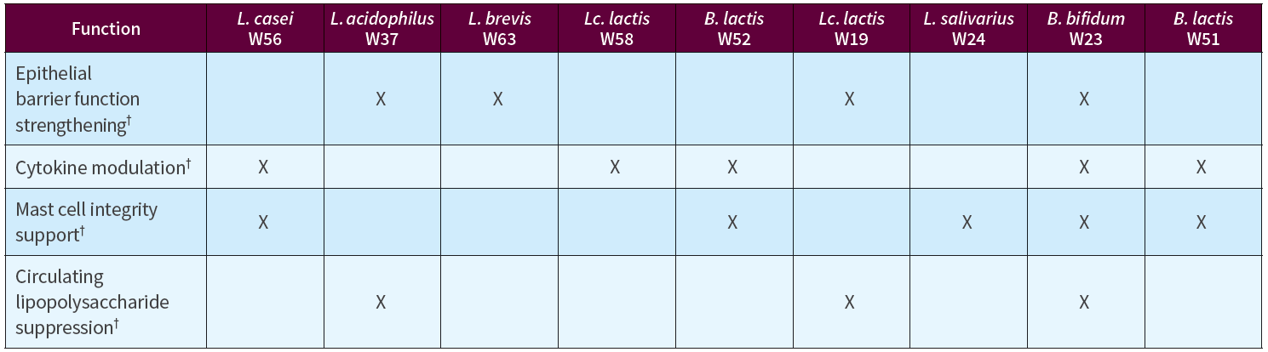
Ecologic BARRIER Strain Selection
Barrier function (% TEER)
Cytokine modulation
MAST cell stabilization
Suppression of circulating LPS
Food Nutr Sci. 2014;5:1739-45.

Slide 11
Effect of Strains on Barrier Function
Stressor + strain
Met welk instituut?
Notes:
Graph: PBMC’s. pg/ml
Most strain in Ecologic Barrier are able to stimulate IL 10 production.
The more IL 10 the better: keep the immune system balanced.

Slide 12
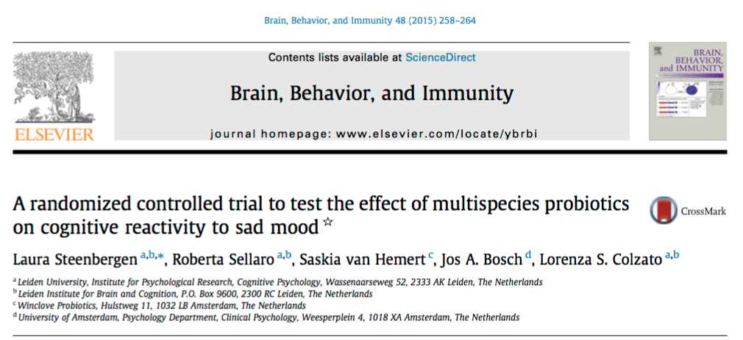
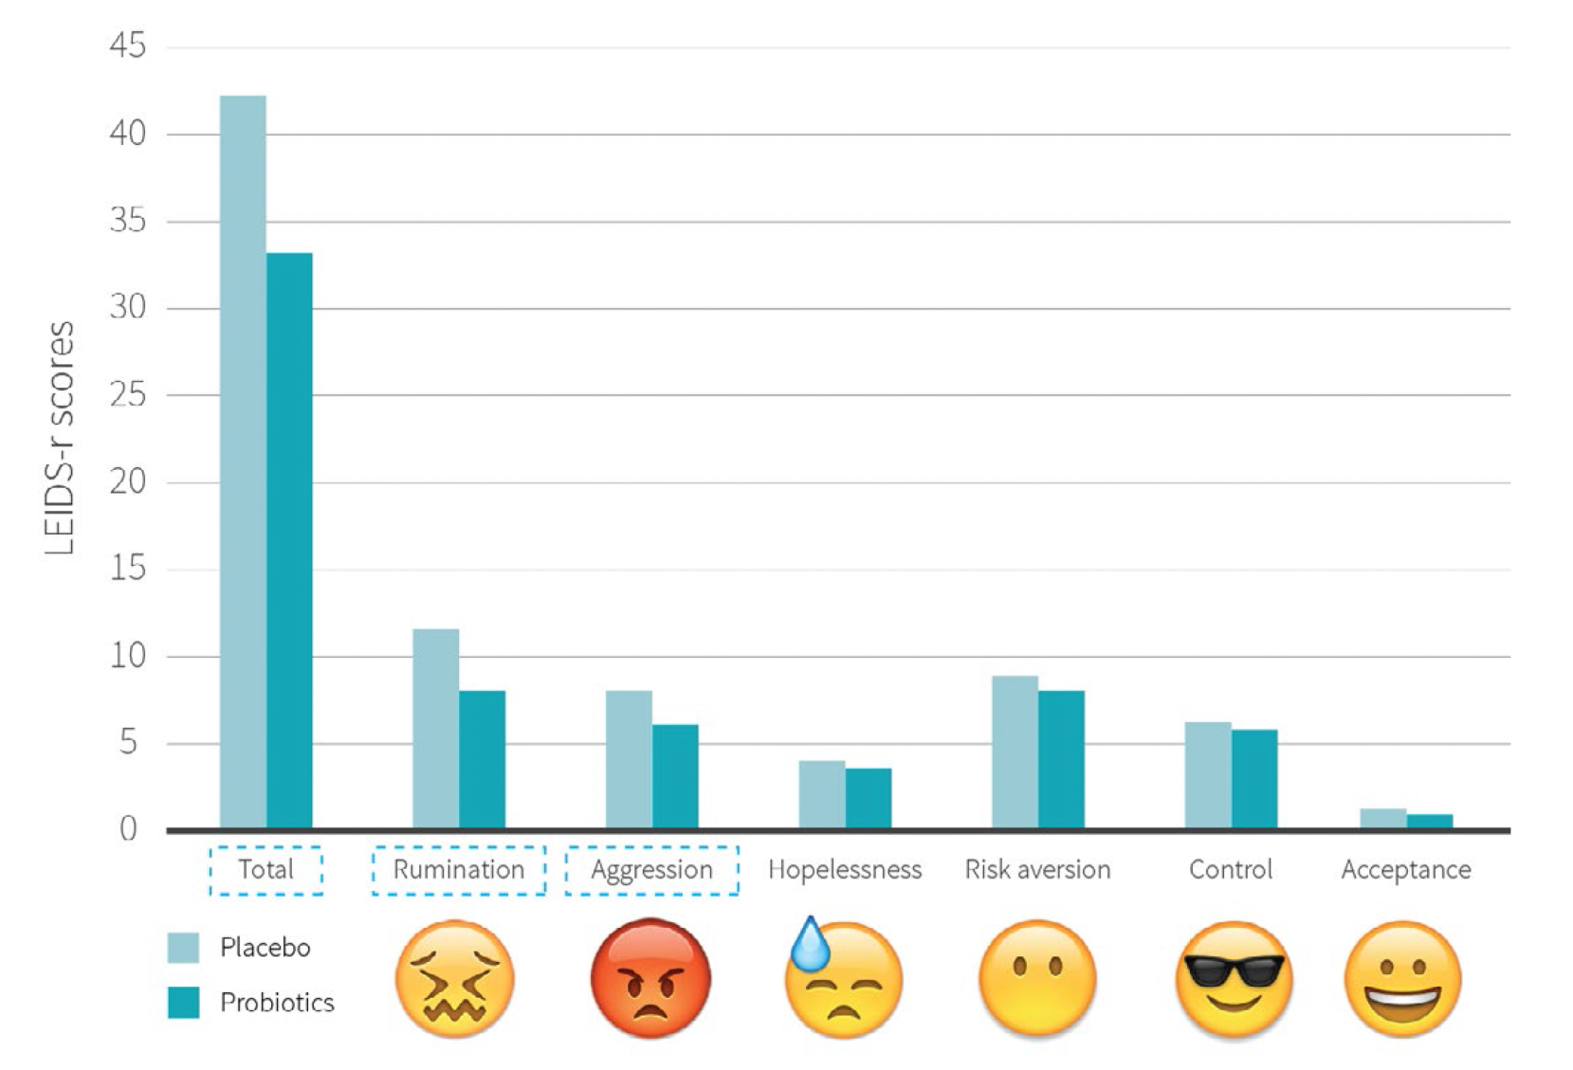
Randomized, Controlled Clinical Trial:
cognitive reactivity to sad mood
*
*
*
Brain Behav Immun. 2015 Aug;48:258-64.
Notes:
One of the studies reviewed in the meta-analysis is quite interesting, in my opinion. It concerns the question of whether probiotics can PREVENT depression.
Steenbergen L, Sellaro R, van Hemert S, et al. A randomized controlled trial to test the effect of multispecies probiotics on cognitive reactivity to sad mood. Brain, Behavior, and Immunity 48 (2015) 258–264.
Objective: Heightened cognitive reactivity to normal, transient changes in sad mood is an established marker of vulnerability to depression and is considered an important target for interventions. So they tested a multispecies probiotic called ECOLOGIC BARRIER, containing 9 strains: a combination of BIFIDO, LACTOBACILLI, and LACTOCOCCI, i.e., Bifidobacterium bifidum W23, Bifidobacterium lactis W52, Lactobacillus acidophilus W37, Lactobacillus brevis W63, Lactobacillus casei W56, Lactobacillus salivarius W24, and Lactococcus lactis (W19 and W58) may reduce cognitive reactivity in non-depressed individuals.
Design: In a triple-blind, placebo-controlled, randomized, pre and post-intervention assessment design (n=40), 20 healthy participants without current mood disorder received a 4-week probiotic food-supplement intervention with the multispecies probiotics, while 20 control participants received an inert placebo for the same period. In the pre- and post-intervention assessment, cognitive reactivity to sad mood was assessed using the revised Leiden index of depression sensitivity scale.
Results: Compared to participants who received the placebo intervention, participants who received the 4-week multispecies probiotics intervention showed a significantly reduced overall cognitive reactivity to sad mood (by 24%), which was largely accounted for by reduced rumination (decreased 28%) and aggressive thoughts (decreased 29%).
Conclusion: These results provide the first evidence that the intake of probiotics may help reduce negative thoughts associated with sad mood. Probiotics supplementation warrants further research as a potential preventive strategy for depression.
DOSE: 5 bn CFU/day

Slide 13
Ecologic BARRIER
One Psychiatrist’s Experience
Scot Bay, MD

Slide 14
34 year old Female
History
  Chronic depression and anxiety
  Concurrent IBS
  Exacerbated by relationship struggles and job change
Chief Complaint
  Depression
  Anxiety
Plan
  Sertraline 100 mg qid
  Trazadone 50 mg hs bid
  Ecologic BARRIER 5B CFU bid
Outcomes

Slide 15
72 year old Female
History
  Chronic severe depression
  Medications stabilize mood with significant GI side effects
Chief Complaint
  Depression
  Diarrhea
Plan
  Duloxetine 90 mg qd
  Buproprion 450 mg qd
  Ecologic BARRIER 5B CFU bid
Outcomes (4 weeks)
  Significant improvement in diarrhea
  Slight, but noticeable, improvement in mood

Slide 16
43 year old Female
History
  Recent significant psychosocial stress (divorce, move)
  Medications partially effective
Chief Complaint
  Anxiety
Plan
  Escitalopram 30 mg qd
  Ecologic BARRIER 5B CFU bid
Outcomes (4 weeks)
  Slight, but noticeable, improvement in mood

Slide 17
52 year old Female
History
  Chronic, severe treatment-resistant depression
Chief Complaint
  Depression
  Delayed gastric emptying (diarrhea)
Plan
  Vilazodone 10 mg qd
  Ecologic BARRIER 5B CFU bid
Outcomes (4 weeks)
  Slight, but noticeable, improvement in mood
  Improvement in digestive symptoms

Slide 18
47 year old Male
History
  Chronic, severe treatment-resistant depression
Chief Complaint
  Depression
  Diarrhea
Plan
  Panlor 50 mg qd
  Ecologic BARRIER 5B CFU bid
Outcomes (4 weeks)
  Slight, but noticeable, improvement in mood
  Complete remission of diarrhea

